Slide 1

Introduction to Framebuffers & Pixel Buffers
A speed run through containers
http://www.gameplayer.com.au/gametube-mario-64-tas-speed-runs/

Slide 2
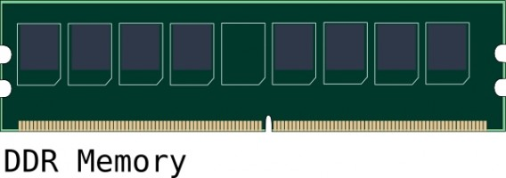


The basic concept (A Memory Buffer)
Main (CPU)Memory
Buffers store data in memory.
Framebuffers and pixel buffers are specialized buffers for storing visual data.
Data is nothing without meaning.

Slide 3
Pixel Buffer vs Framebuffer
Traditionally, Pixel Buffers and Frame Buffers were just buffers.
Pixel Buffer
Framebuffer
Stores Data about Pixels
Stores Data about Pixels
Transformations
Transformations
Drawing Operations
Drawing Operations

Slide 4
Pixel Buffer vs Framebuffer
The variations depend on the toolkit.
Pixel Buffer
Framebuffer
Stores Data about Pixels
Stores Data about Pixels
Transformations
Transformations
Drawing Operations
Drawing Operations
CPU (Software) Rendering
GPU (Hardware) Rendering
Not connected to an OpenGL Texture
Connected to an OpenGL Texture
But for now - add these general usage variations.
https://www.opengl.org/wiki/Pixel_Buffer_Object
https://www.opengl.org/wiki/Framebuffer_Object

Slide 5
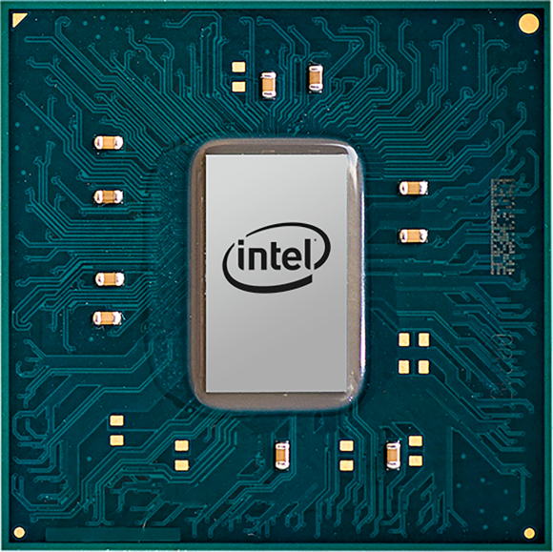
Software Rendering
Request Pixel Buffer Creation
40x40
40
40
pixmap->drawLine(10,10,30,30)
screenFrame->drawPixmap(pixmap,10,10,40,40)

Slide 6

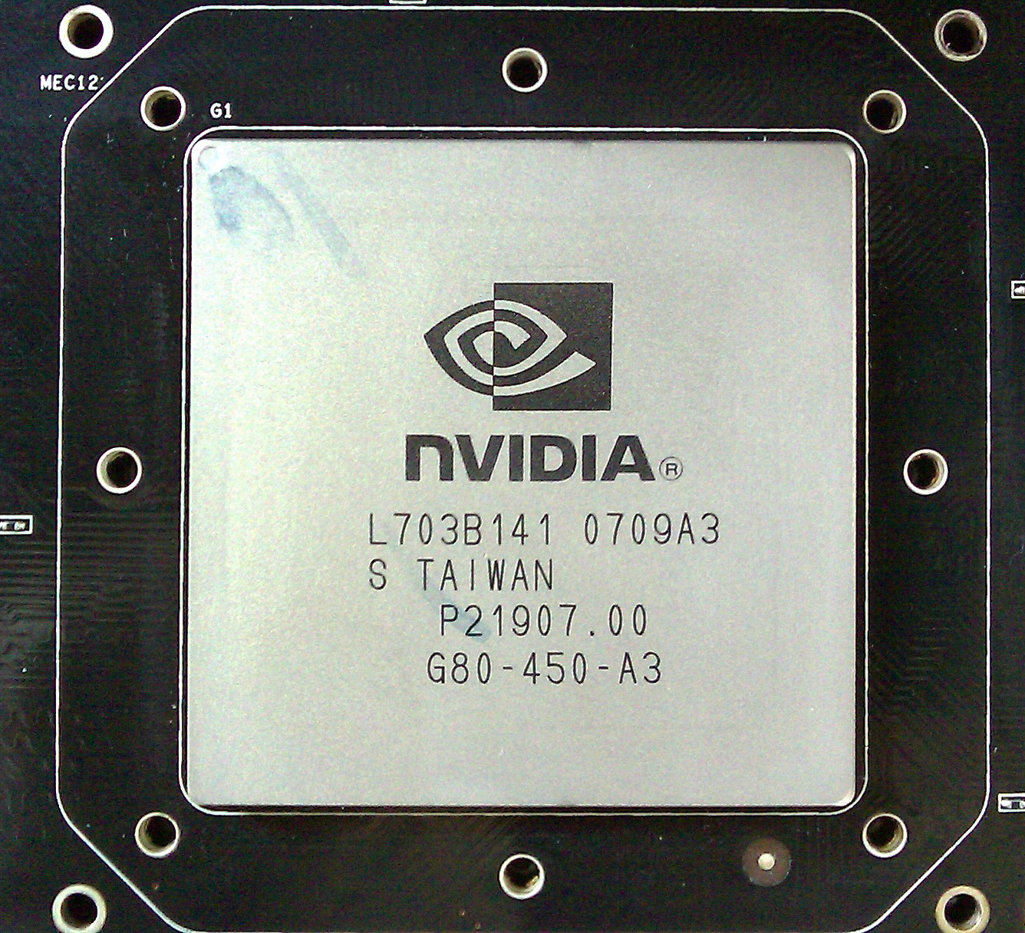
Hardware Rendering
Request Opengl Context
Request Pixel Buffer Creation
40x40
40
Create vector describing line lineVector[10,10,30,30]
40
frameBuffer->drawVector(10,10,lineVector)
frameBuffer->swapBuffer()

Slide 7
Takeaway
Pros and Cons to both
Hardware Rendering is not always available
Software Rendering is slow
More setup for HW Rendering
Without threading SW rendering almost doesn’t work
There is more than one type of memory (CPU & GPU)

Slide 8
3 Basic Elements Needed to Draw an Image
Renderer
DataSet
(Bitmap)
Hardware Abstraction Layer
(HAL)

Slide 9
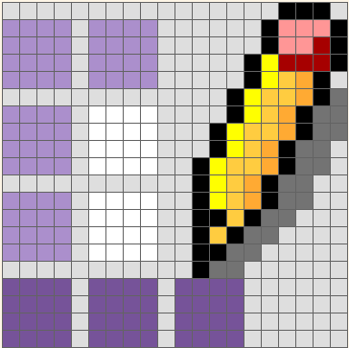
What is a bitmap?
A collection of bits (now more commonly bytes) representing an image. The data is formatted (optimized) for the display.
Bitmap
NOTE - Bitmap is a general term and also a file format, they are not the same.

Slide 10
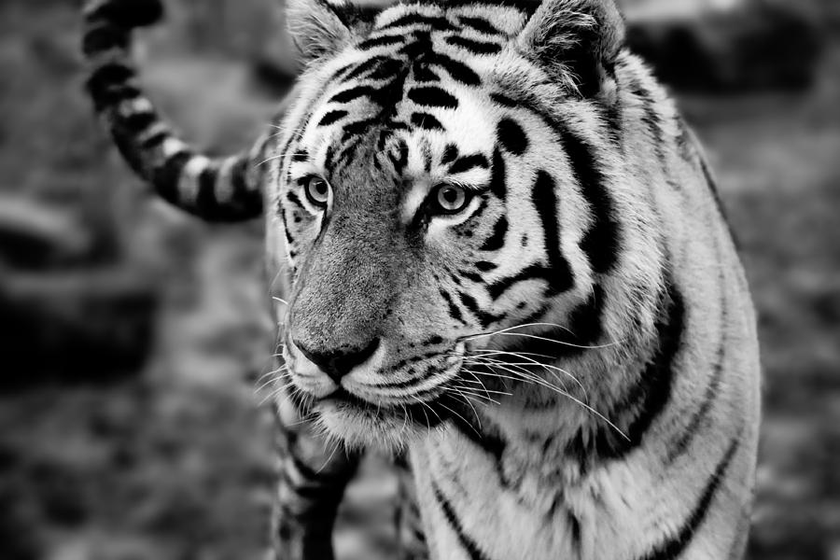
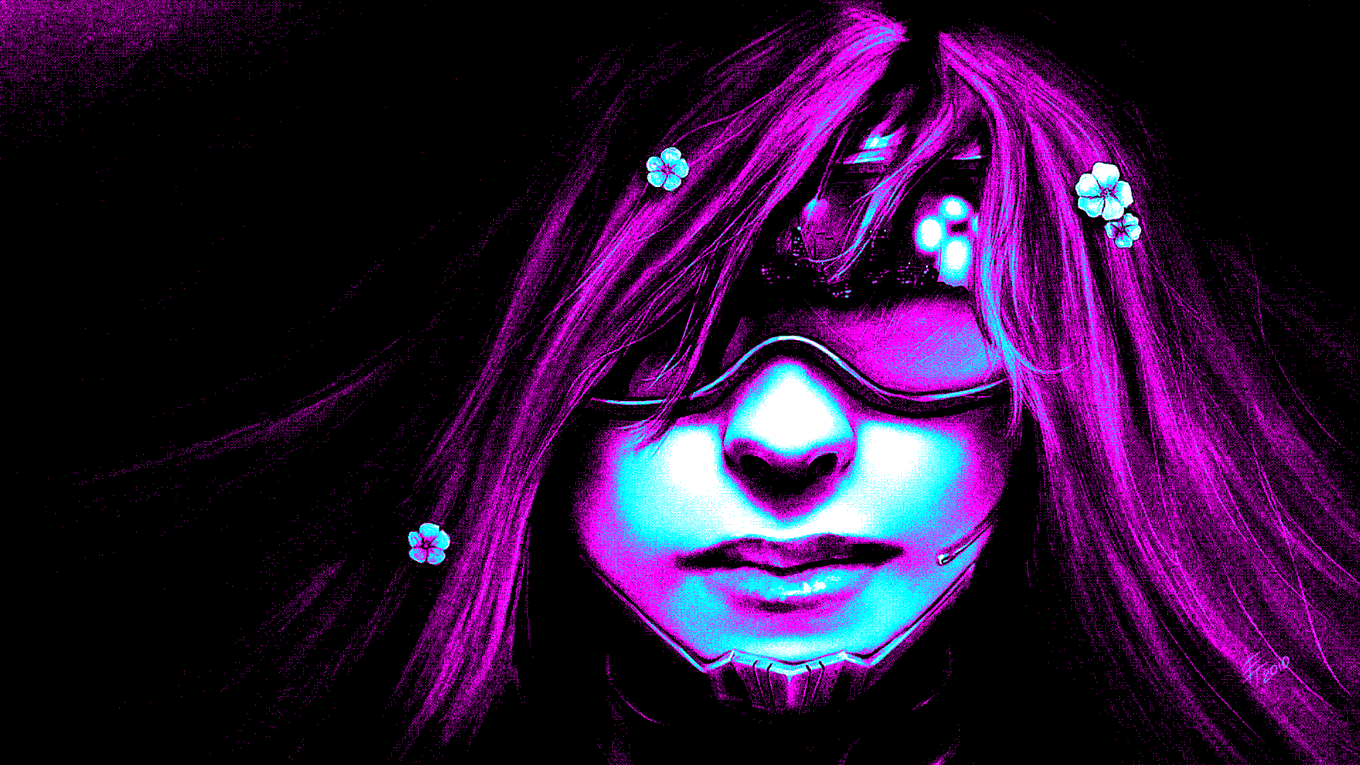
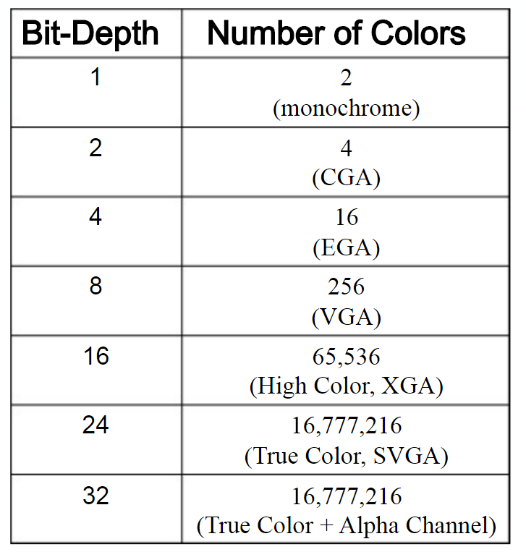
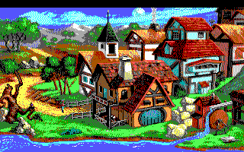
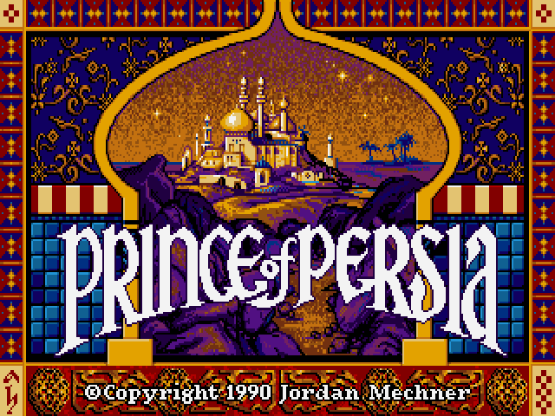

Color Depth
http://slideplayer.com/slide/6216504/

Slide 11
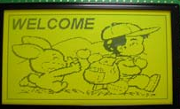
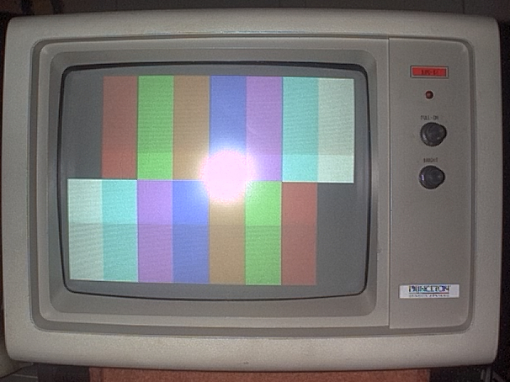
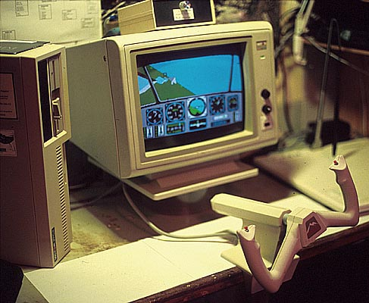
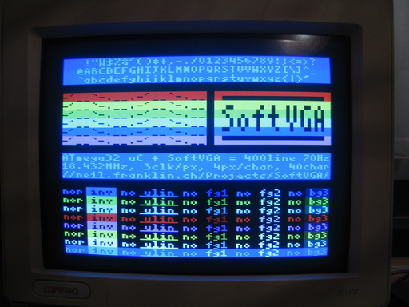
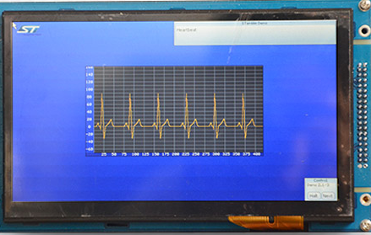
Optimized for Display
http://slideplayer.com/slide/6216504/

Slide 12
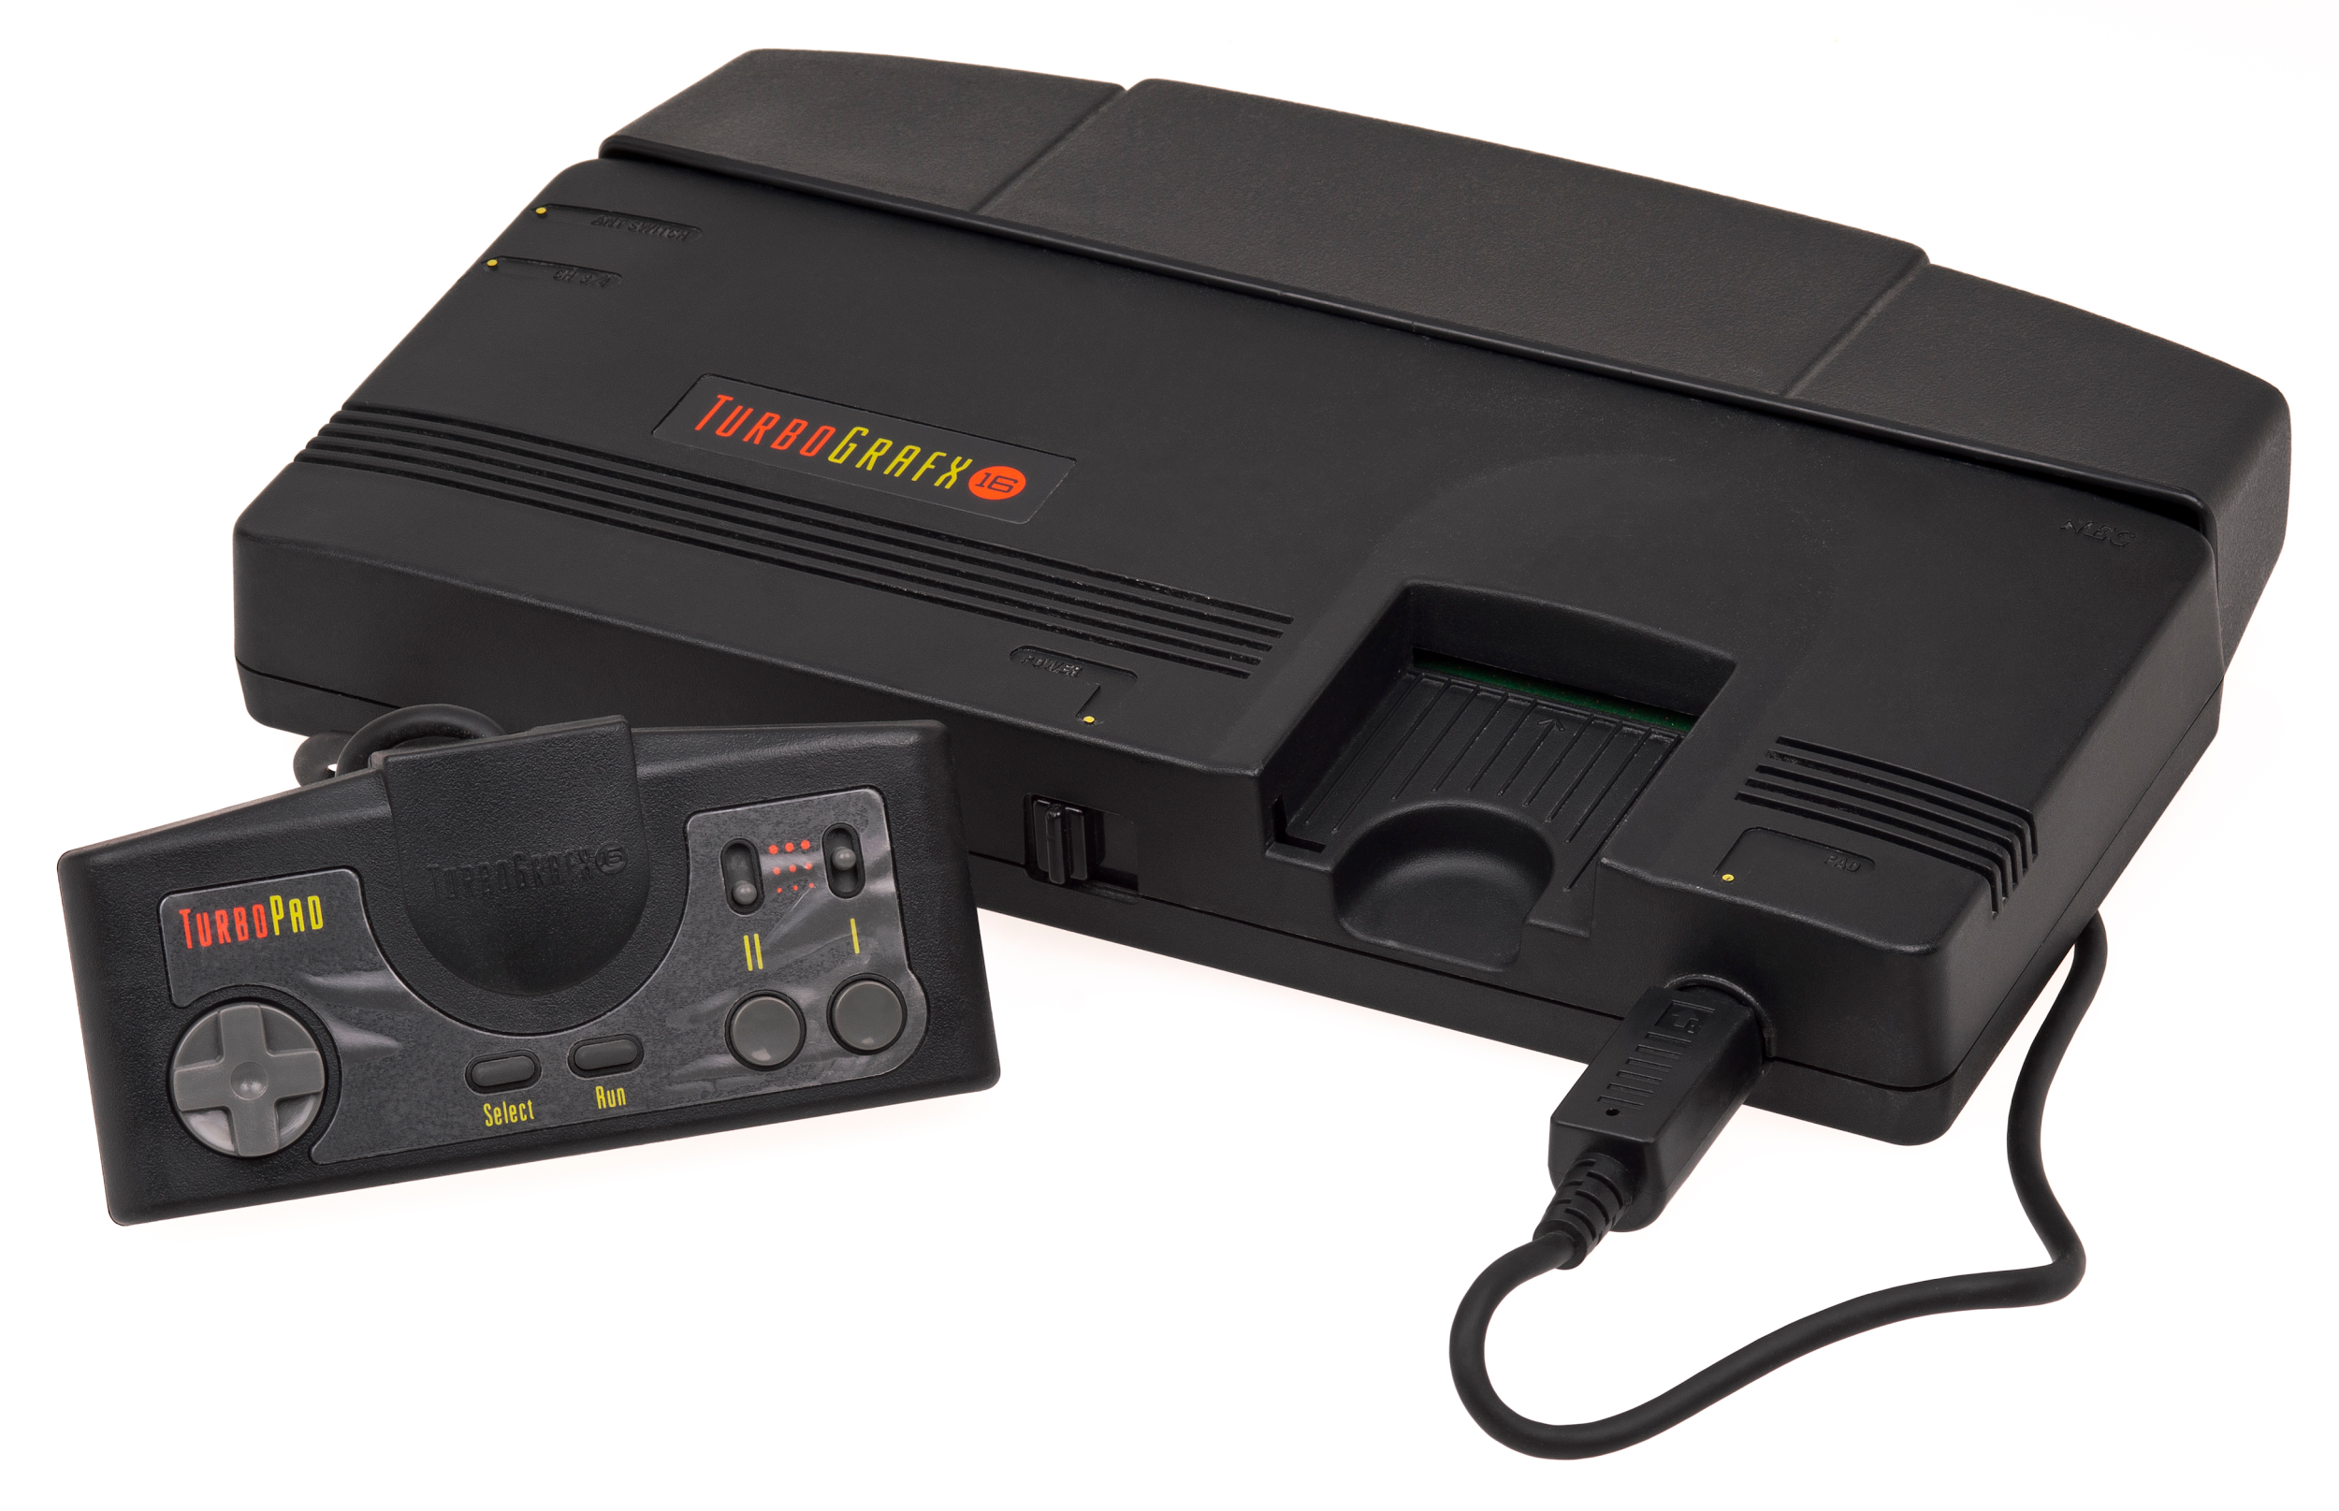
Hardware limitations
What if your hardware only allows 16-bit grafx?

Slide 13
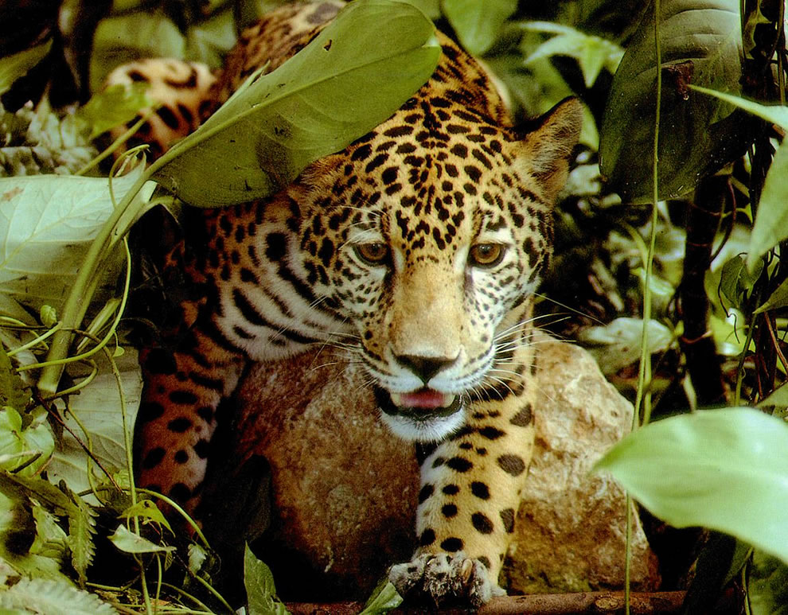
32-bit RGBA
The more colors (depth) the better image?

Slide 14
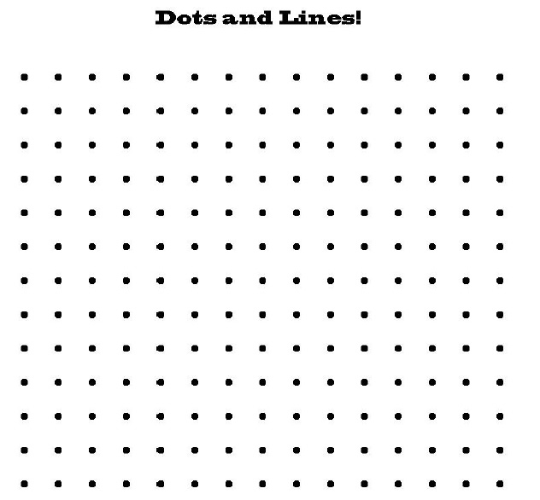
32-bit RGBA (Wasted)
More colors (depth) do not guarantee better content!

Slide 15
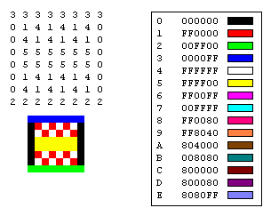
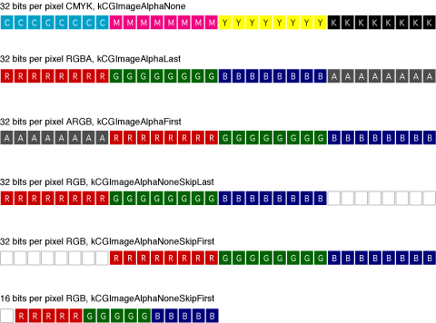
Real World Examples (BMPs)
4 Bits
24 Bits
The color table allows sharing color palette information only once. Then the main data stores a reference to the (lookup) table.
0 1 0 0 0 0 0 1 0 0 0 0 1 0 0 0 1 0 0 0 1 1 0 0
https://msdn.microsoft.com/en-us/library/windows/desktop/ms536393(v=vs.85).aspx

Slide 16
Real World Examples (Different Formats)
4 Bits
24 Bits
The color table allows sharing color palette information only once. Then the main data stores a reference to the (lookup) table.
https://msdn.microsoft.com/en-us/library/windows/desktop/ms536393(v=vs.85).aspx

Slide 17
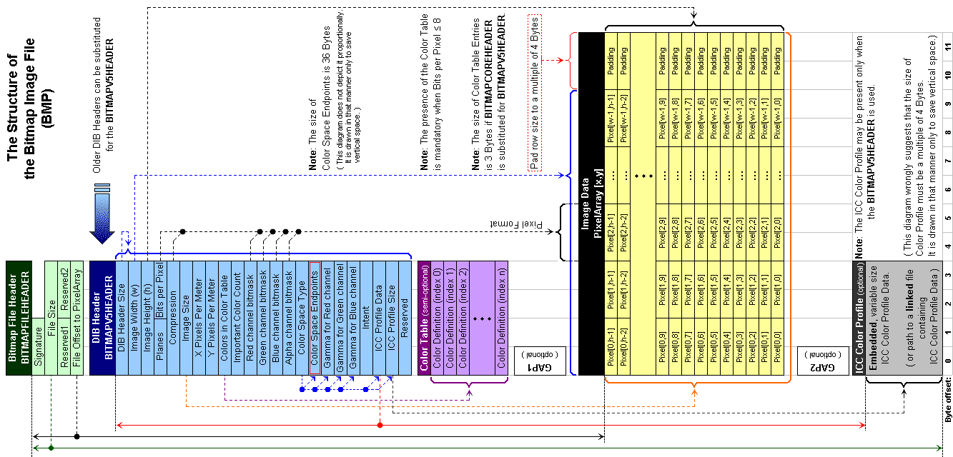
Real World Examples (Bitmaps - Technical)

Slide 18
Takeaway
File Formats store data differently
Each format has strengths and weaknesses
Most images won’t require RGBA

Slide 19
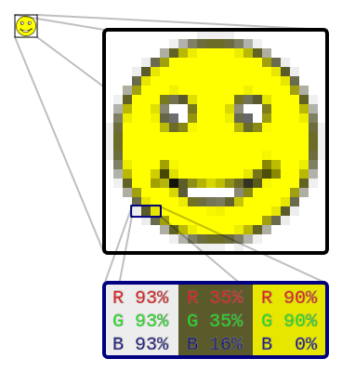
Rendering (Raster)
Traditionally
Performed by a CPU
(Before GPUs were common)
Had scan lines (rake)
Pixel by Pixel, Line by Line
https://en.wikipedia.org/wiki/Raster_graphics

Slide 20

Rendering (Raster)
Now more often used in
Software Rendering
(Pixmap Rendering)
Printers (Raster Image Processor)
Copy one raster image into another is similar to a memcpy operation. New data replaces the old data.
https://en.wikipedia.org/wiki/Raster_graphics

Slide 21
Rendering (Raster)
Now more often used in
Software Rendering
(Pixmap Rendering)
Printers (Raster Image Processor)
Alternatives?
https://en.wikipedia.org/wiki/Raster_graphics

Slide 22

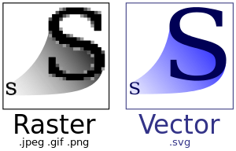
Scalable Vector Graphics
SVG takes a different approach to rendering. Instead of drawing pixel by pixel SVG renderers draw shapes.
Raster images (made of pixels) can be scaled but can only replicate existing pixel data.
‘Pixelation’Occurs
https://en.wikipedia.org/wiki/Scalable_Vector_Graphics

Slide 23
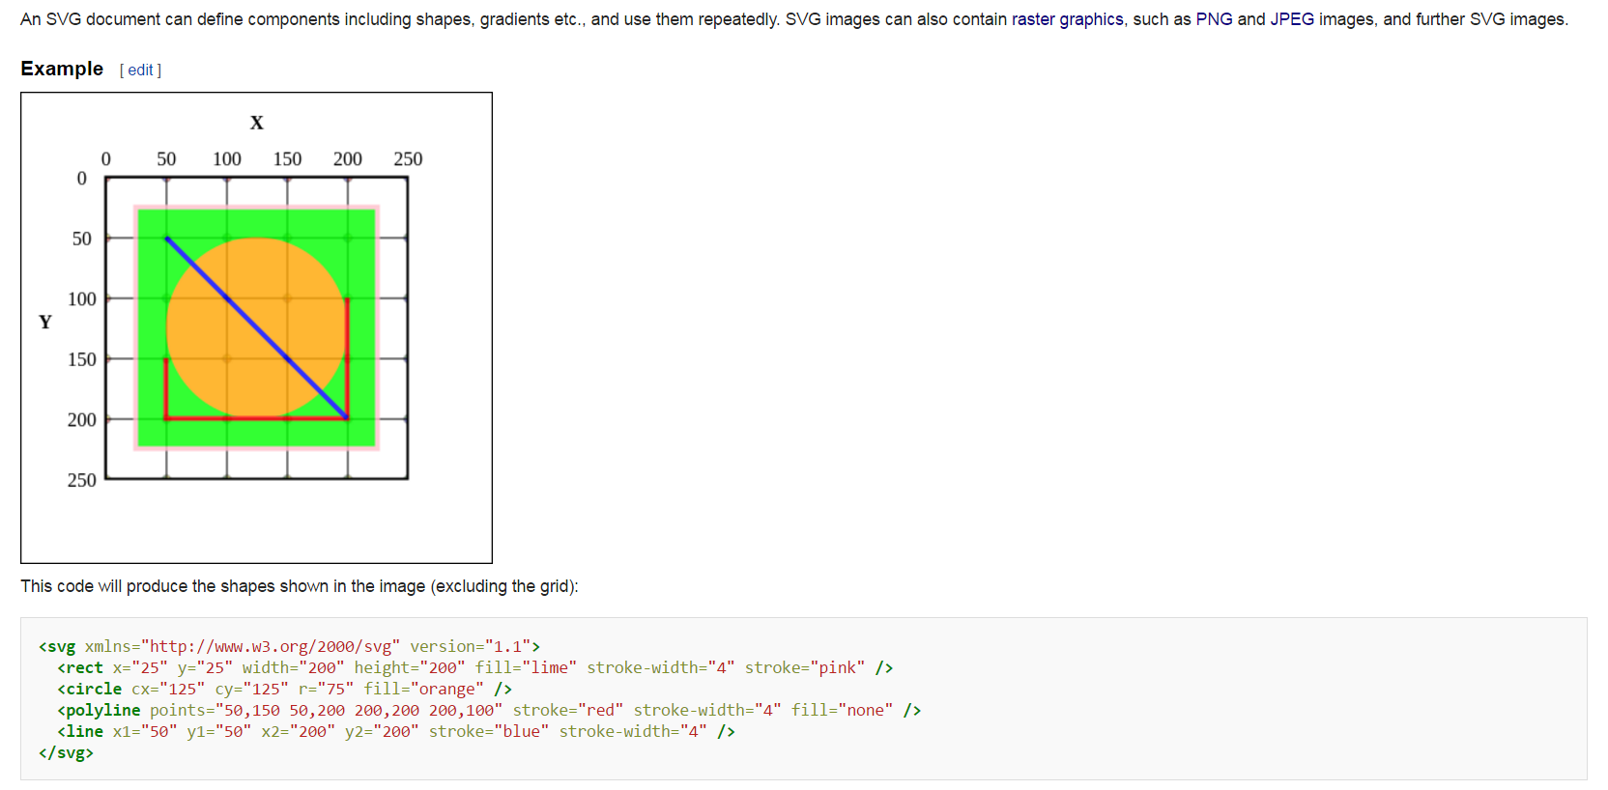
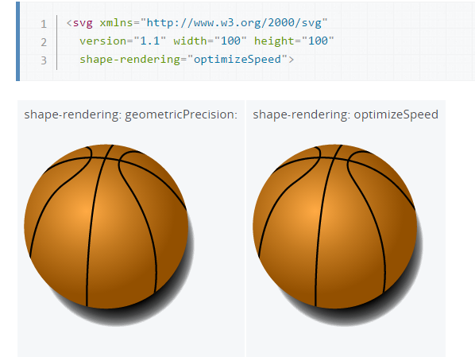
Scalable Vector Graphics (Internal)
Optimization

Slide 24
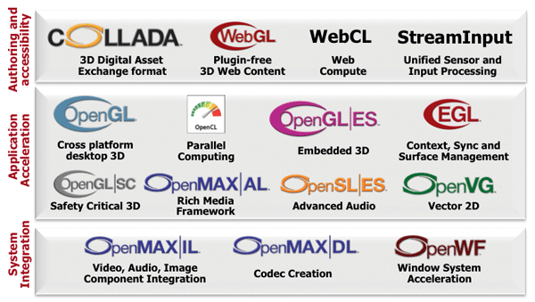
Hardware Rendering (HAL)

Slide 25
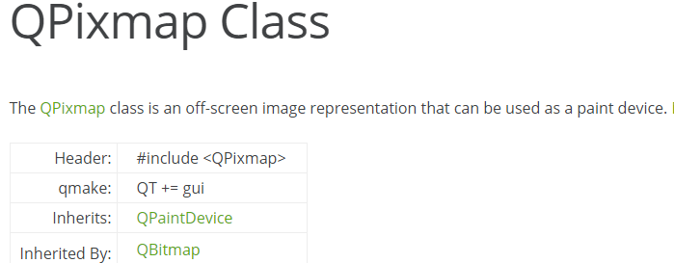
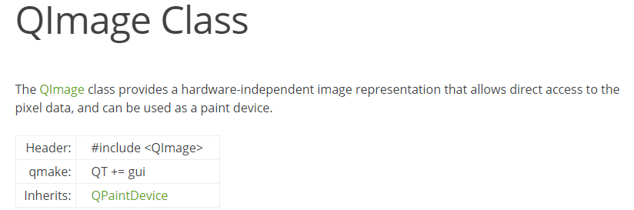
Pixel Buffers in Qt

Slide 26
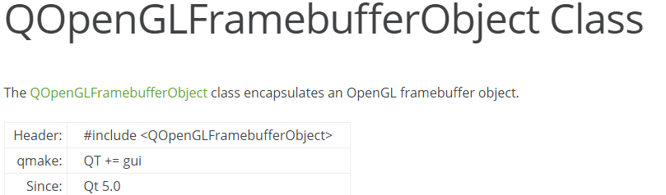
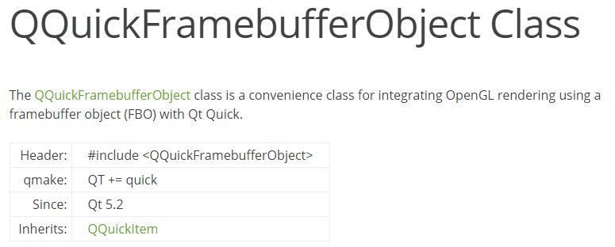
Framebuffers in Qt

Slide 27


Suggested Reading
QML Book (Chapter 15) C++ Integration
http://qmlbook.github.io/en/ch15/index.html
http://doc.qt.io/qt-5/topics-graphics.html

Slide 28
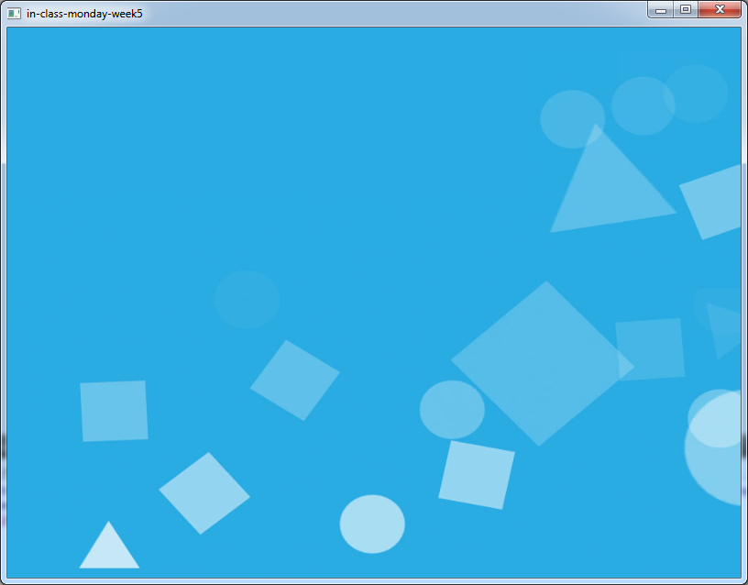
Live Coding Demo
Advanced Input Forwarding

